Slide 1

SC1015
Mini
Project
Group K - Wang Ciyun & Zhang Yuxuan

Slide 2

Heart disease is one of the leading causes of death for people of most races in the US.
Key indicators include obesity (high BMI), smoking or drinking too much alcohol, etc.
Detecting and preventing the factors that have the greatest impact on heart disease is very important in healthcare.
Background

Slide 3
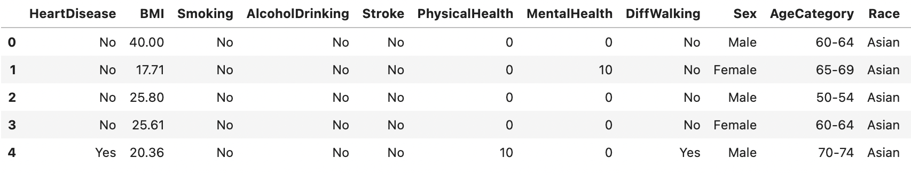
Original dataset consists of 401,958 rows and 279 columns
Race is filtered, more focusing on Asian
Total number of samples: 8068 (After filtering)
Total number of variables we will be analys: 8 variables
Dataset from Kaggle - Personal Key Indicators of Heart Disease

Slide 4
How does the different variables which shows individuals personal habits affect the result of Heart Disease in the dataset.
Goal is to create a optimised Decision Tree that best identify the risk of a personal having Heart disease based on personal habits.
Response Variable: HeartDisease
Numeric Predictor Variables: BMI, PhysicalHealth, MentalHealth, SleepTime
Categorical Predictor Variables: Smoking, AlcoholDrinking, AgeCategory, GenHealth
Problem Formulation
What are the variables?

Slide 5
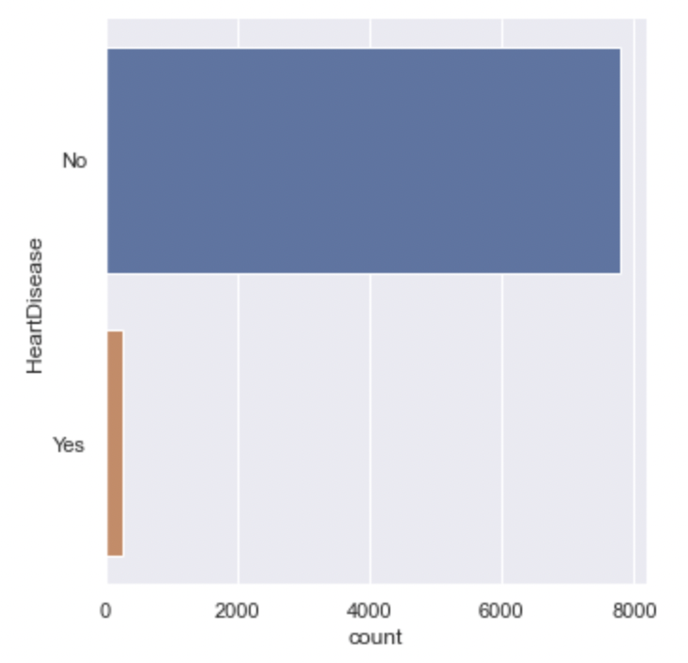

Ratio of Having HeartDisease
No : Yes = 7802 : 266
There is a large class imbalance in the response variable.
Response Variable - HeartDisease

Slide 6
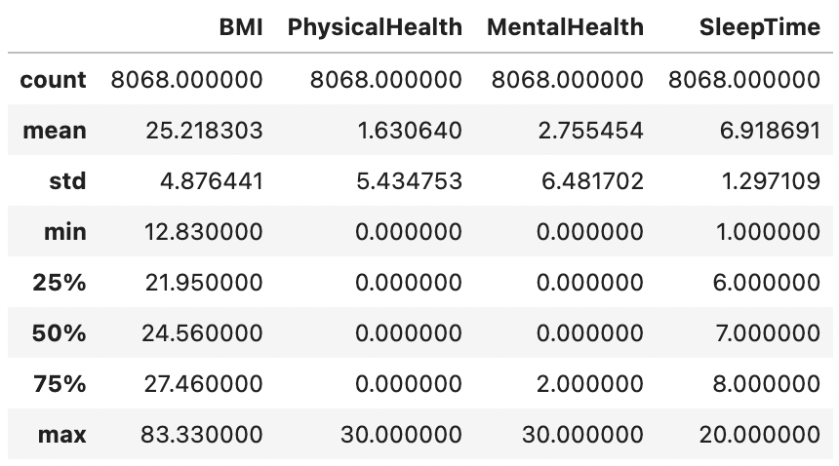
Exploratory Data Analysis - Numeric Variables

Slide 7
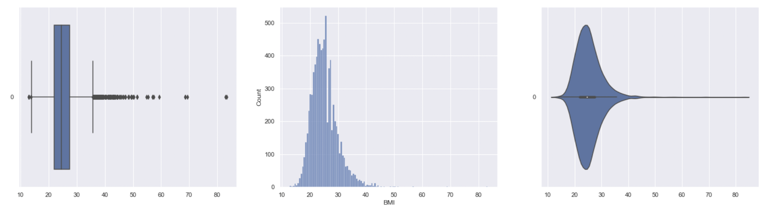
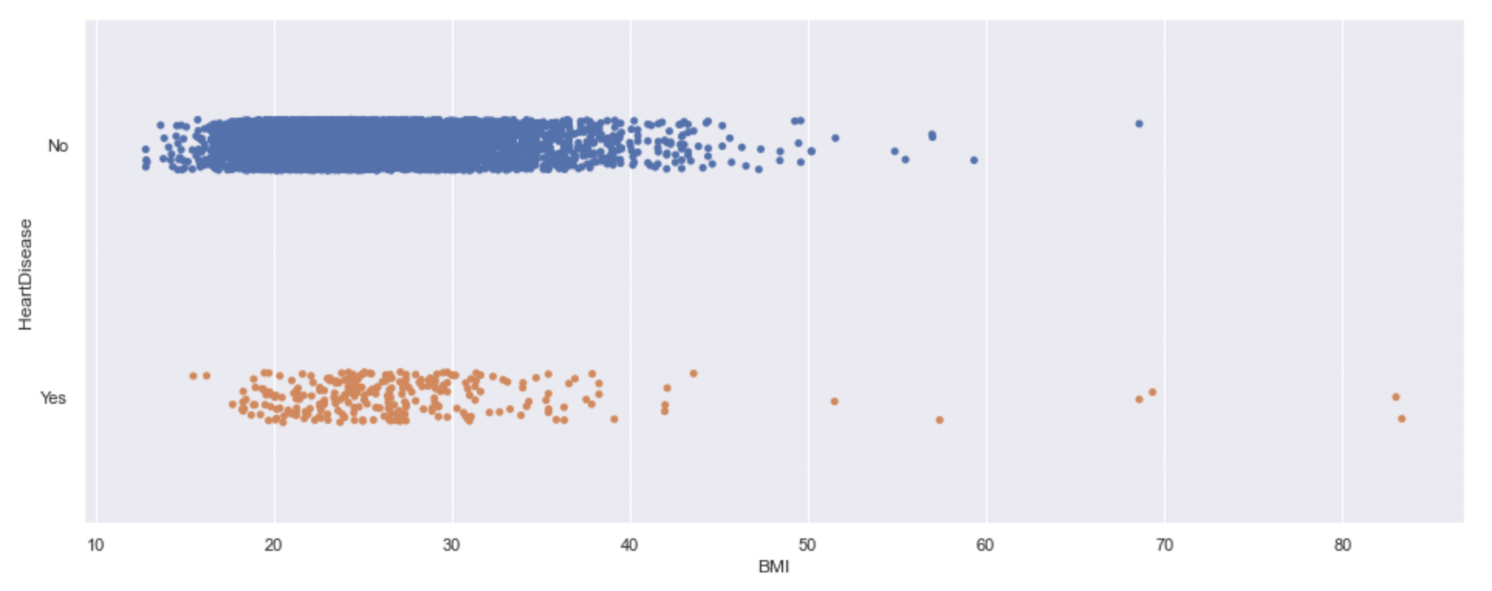
BMI has the median of around 24.56, with 75% of the data in the range of 22 to 27.5.
Most of the Yes entries for HeartDisease falls within the BMI range around 18 to 38.
Useful predictor for the decision tree.
Numeric Variable - BMI

Slide 8
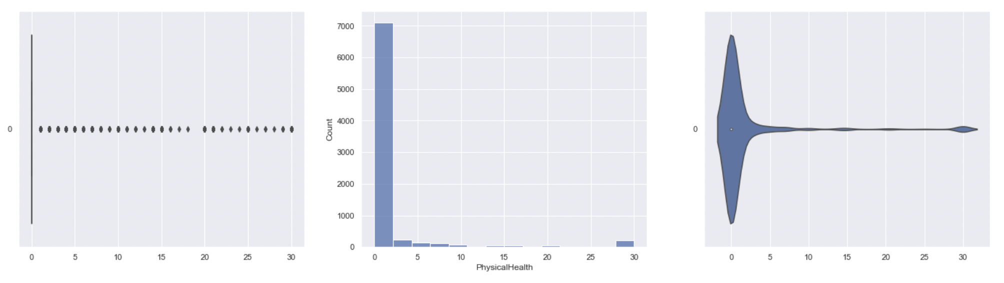
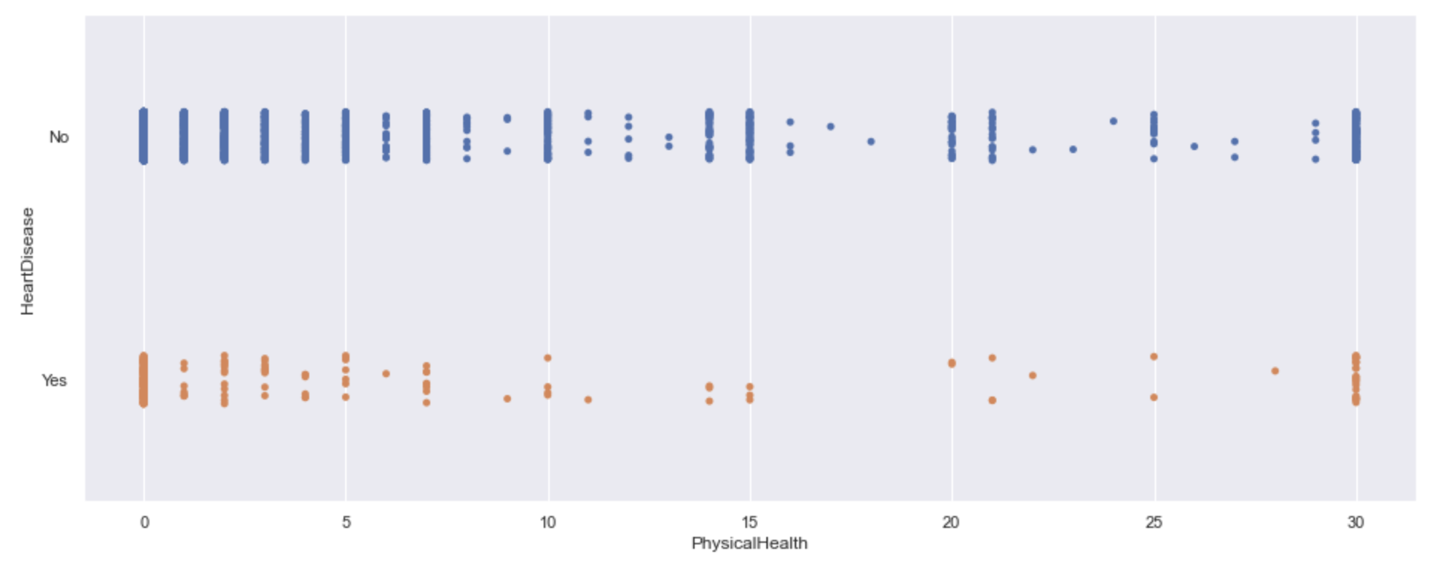
Distribution of data is very uneven.
Yes entries for HeartDisease falls within the entire range for PhysicalHealth.
The huge amount of distribution data located at value 0.
Not a useful predictor for the decision tree.
Numeric Variable - PhysicalHealth

Slide 9
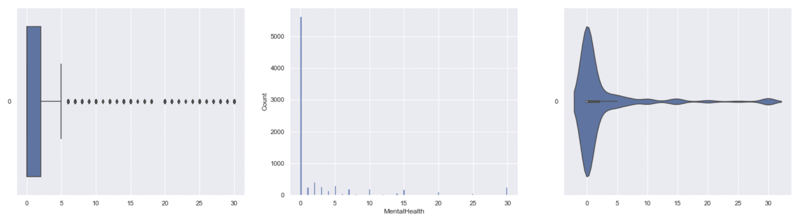
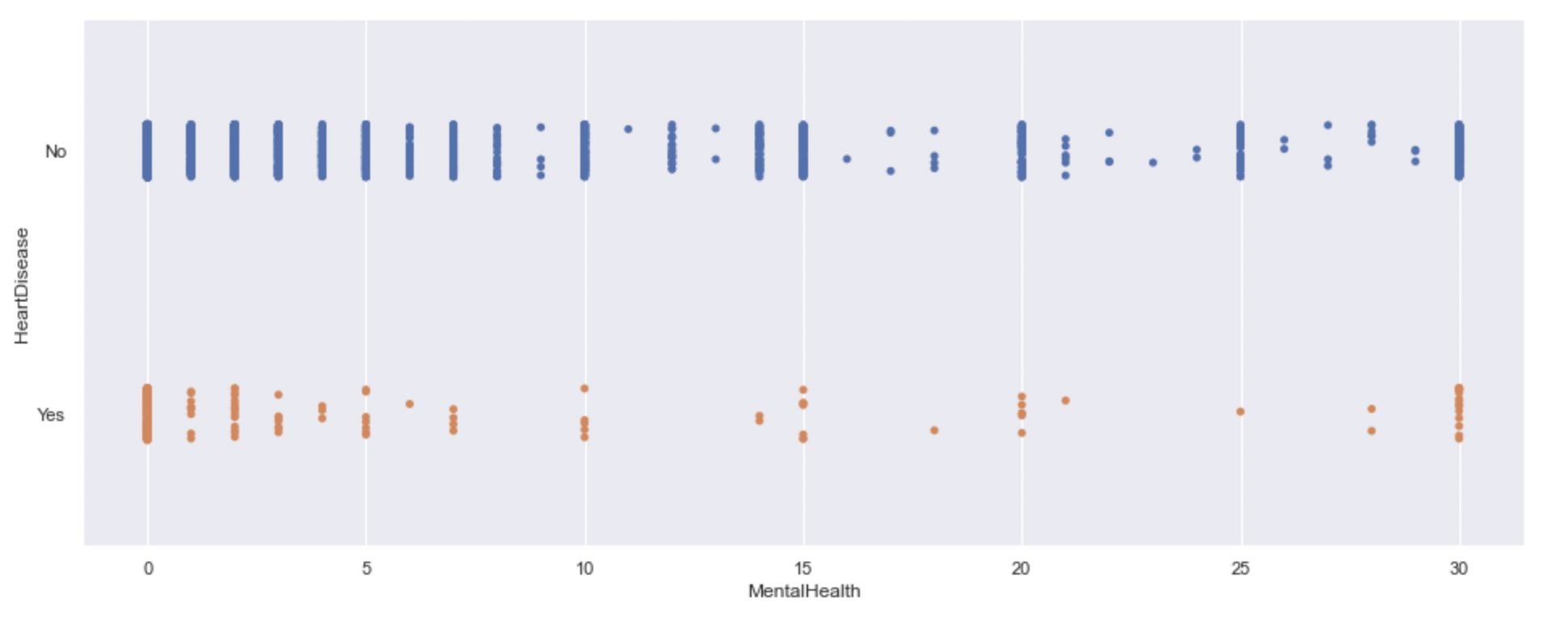
Distribution of data is very uneven.
Yes entries for HeartDisease falls within the entire range for MentalHealth.
The huge amount of distribution data located at value 0.
Not a useful predictor for the decision tree.
Numeric Variable - MentalHealth

Slide 10
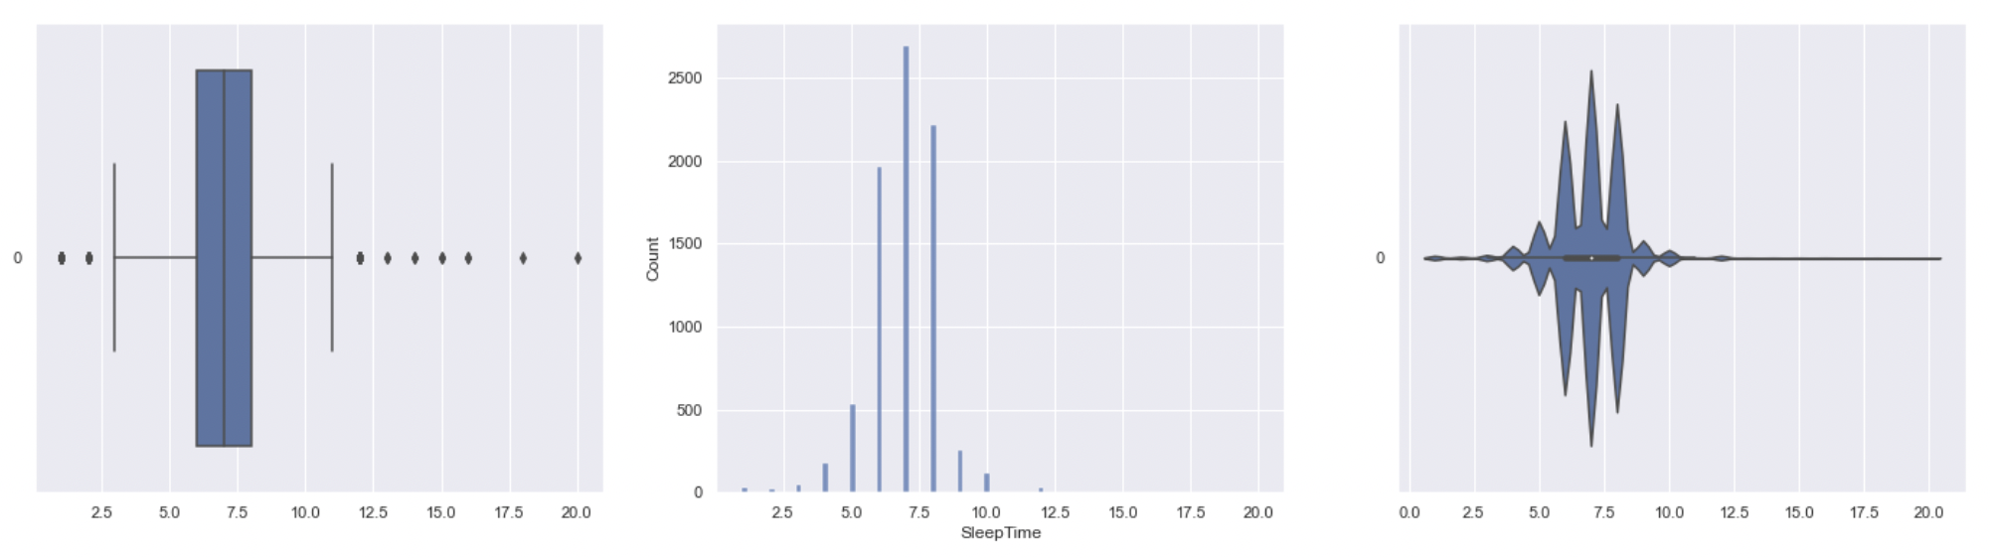
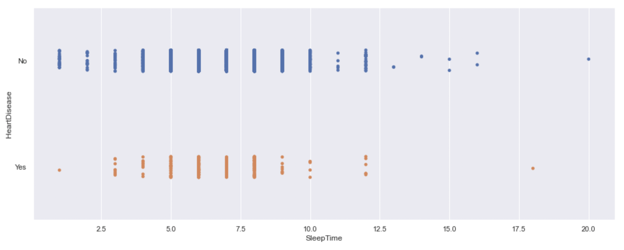
75% of the data in the range of 6 to 8 hours.
Most entries falls within the range around 4 to 9 for SleepTime.
Useful predictor for the decision tree.
Numeric Variable - SleepTime

Slide 11
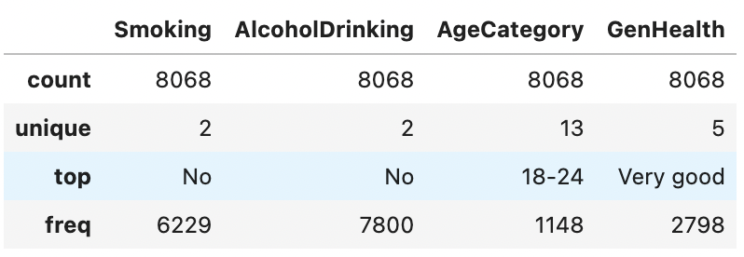
Exploratory Data Analysis - Categorical Variables

Slide 12
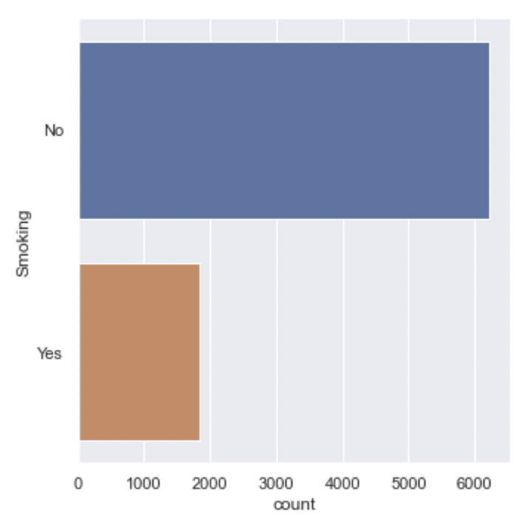
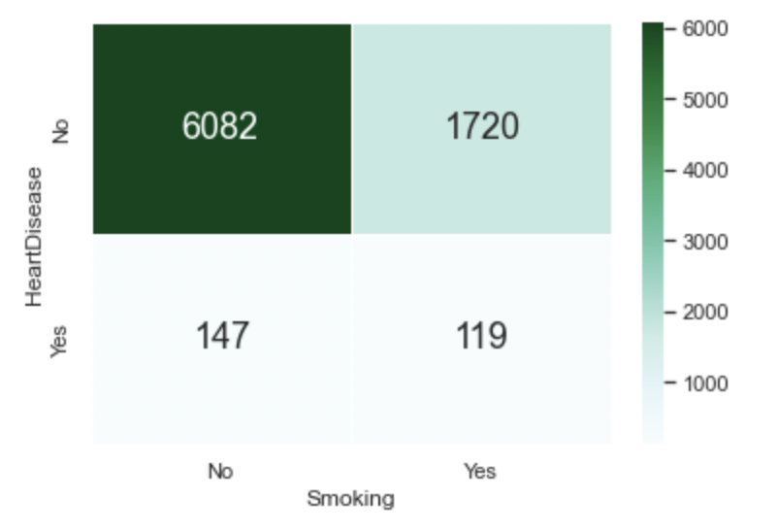
The entries ratio for HeartDisease when smoking is no is about 40:1 and 15:1 when yes, which is fair to say that if Smoking is No, most likely that the HeartDisease value will be No. It may not be equally obvious when Smoking is Yes as the ratio is only 15:1. However it is still a fairly useful predictor for the decision tree.
Categorical Variable - Smoking

Slide 13
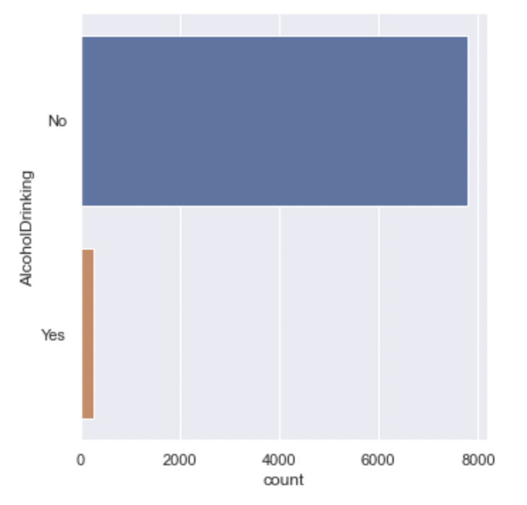
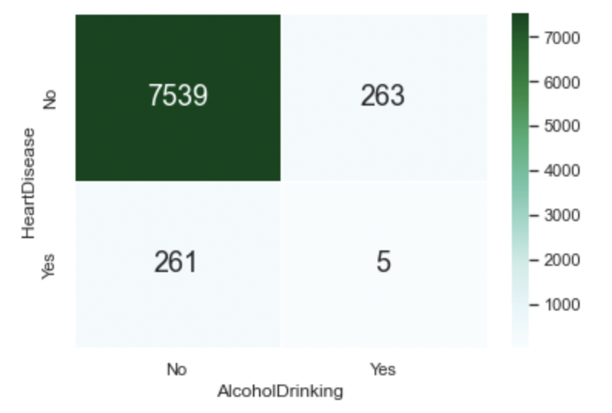
The entries ratio for HeartDisease when AlcoholDrinking is no is about 35:1 and 50:1 when smoking is yes. Which is fair to say that if AlcoholDrinking is No, most likely that the HeartDisease value will be No. And if AlcoholDrinking is Yes, most likely that the HeartDisease value will be No. Therefore it is quit a useful predictor for the decision tree.
Categorical Variable - AlcoholDrinking

Slide 14
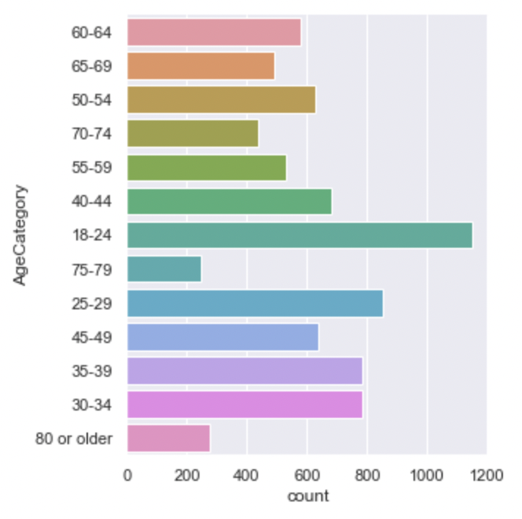
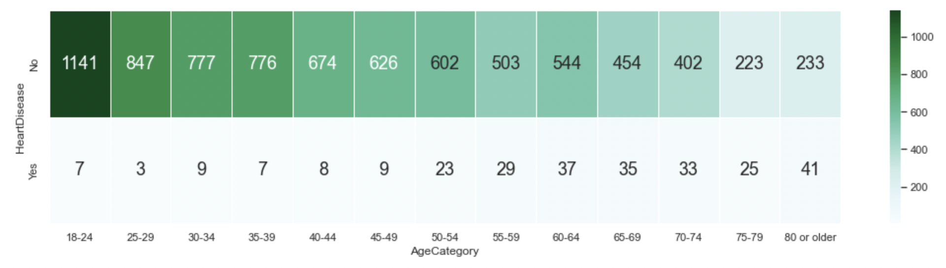
The entries ratio for HeartDisease for each AgeCategory is high from AgeCategory 18-24 to 45-49. The ratio is slightly decrease within the range 50-54 to 70-74 and even lower for range 75-79. The number of yes for HeartDisease is increased when going up the AgeCategory. Therefore it is quit a useful predictor for the decision tree.
Categorical Variable - AgeCategory

Slide 15
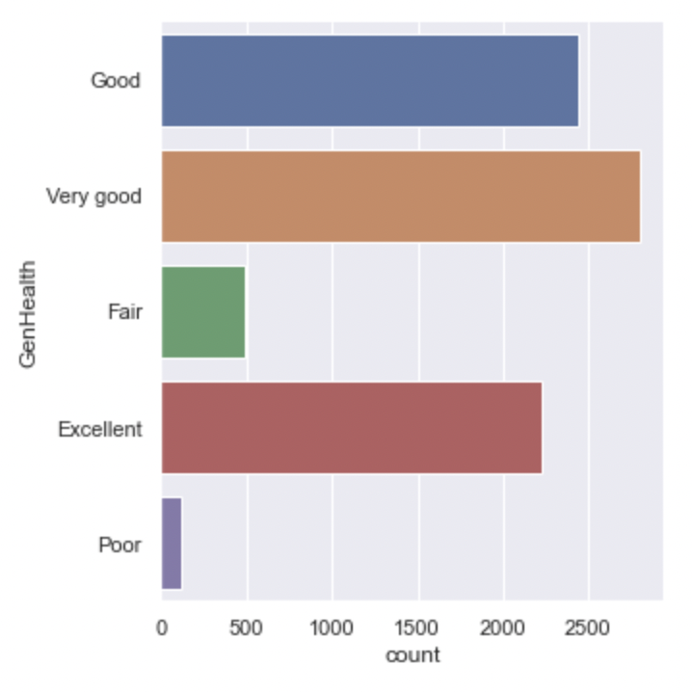
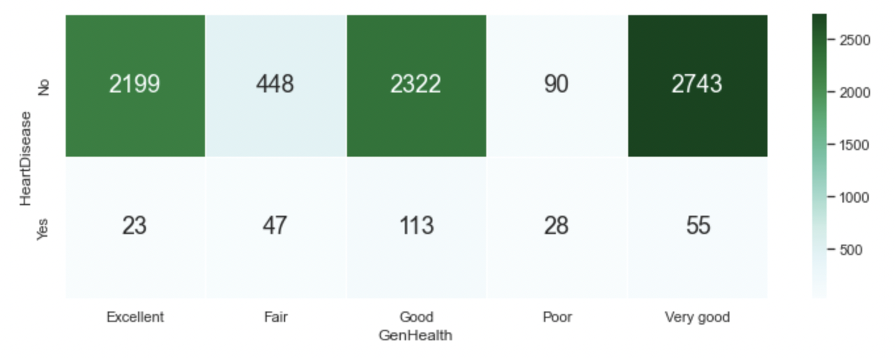
The entries ratio for HeartDisease when GenHealth is Excellent, good and very good is very outstanding. Its is very likely to say that if GenHealth is in these categories, most likely they have no HeartDisease. Therefore it is quit a useful predictor for the decision tree.
Categorical Variable - GenHealth

Slide 16

Decision Tree
Random Forest
GridSearch
Machine Learning

Slide 17
Response Variable: HeartDisease
Numeric Predictor Variables: BMI, SleepTime
Categorical Predictor Variables: Smoking, AlcoholDrinking, AgeCategory, GenHealth
Upsample the Response Variable
Encode the Categorical Variables
Apply another tree based classifier -- RandomForest
Find the best model through GridSearchCV
What are the variables we used in the Decision Tree ?
What we need to do to create the Model ?

Slide 18
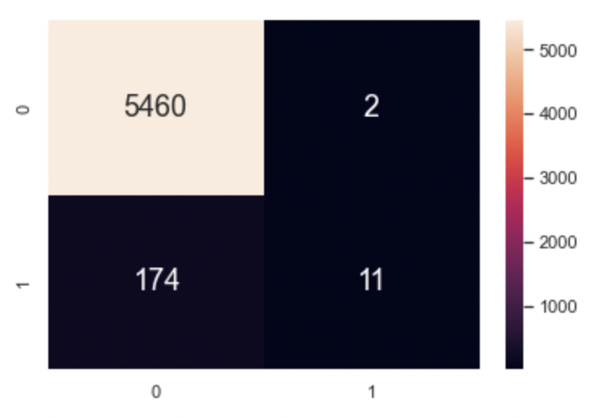
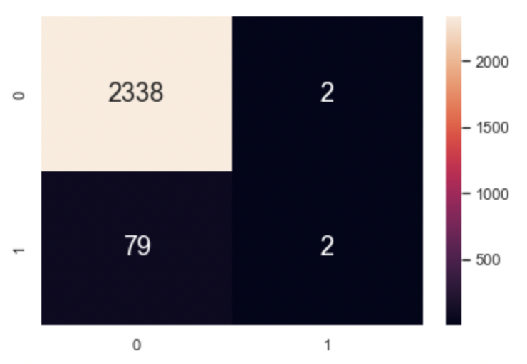
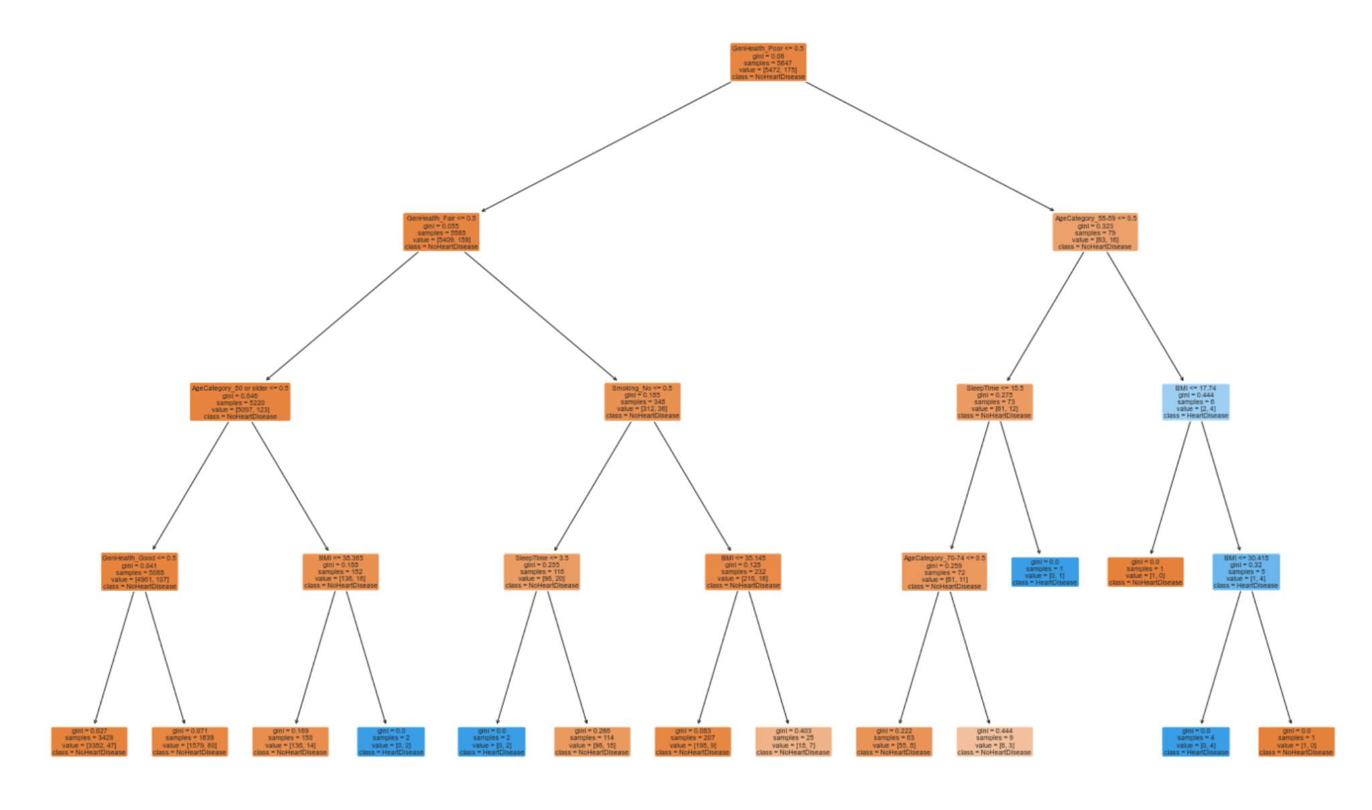
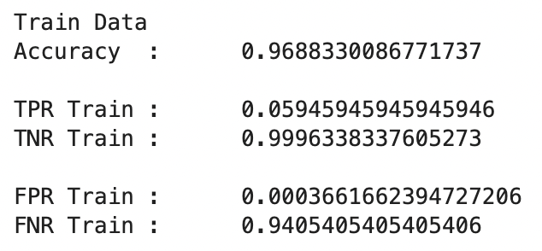
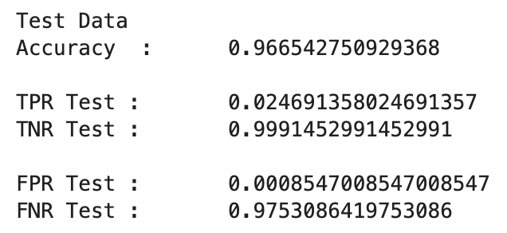
The Accuracy of this Classification for both Train and Test is very high.
Most result falls into True Negative and the counts of True Positive is very low.
Huge imbalance in the False Positives and False Negatives in the confusion matrix.
Only useful to determine the True Negative value, but not useful to determine the True Positive value.
Decision Tree
Encoding

Slide 19
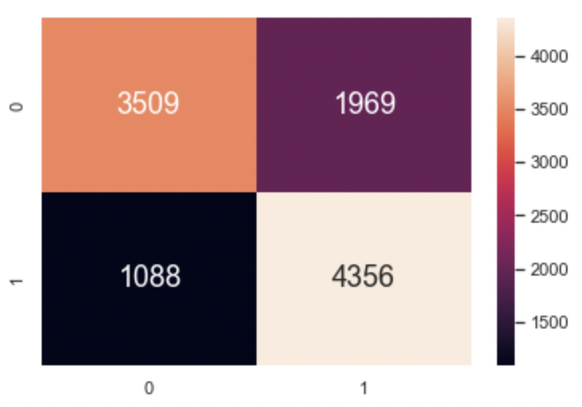
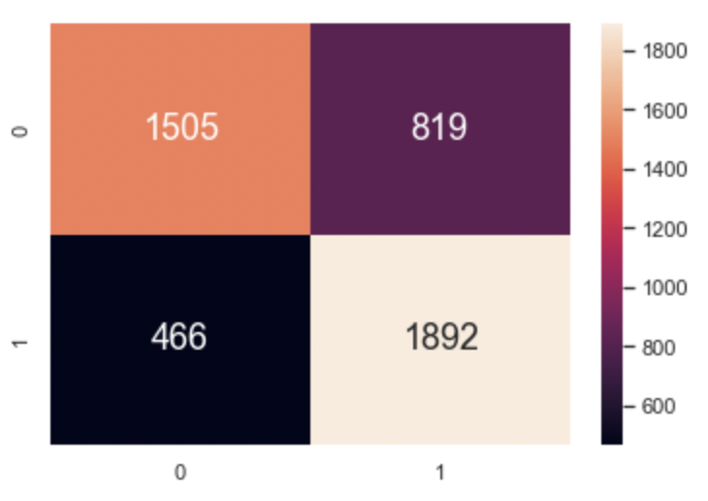
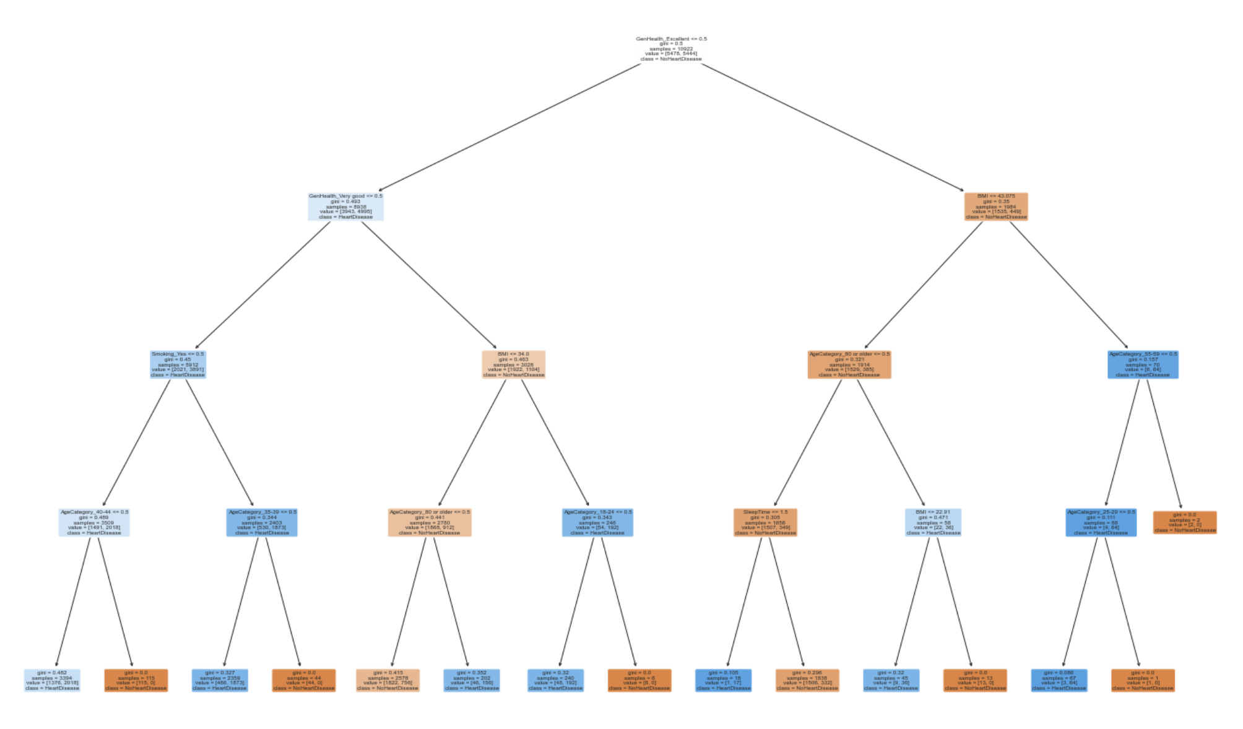
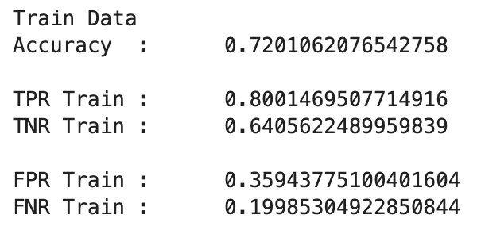
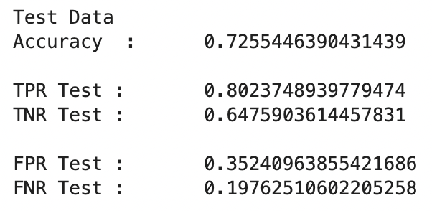
After Upsample, the value of True positive is much higher.
False positives and false negatives are more balanced now.
Able to determine the True Positive value.
Accuracy dropped from around 0.97 to 0.72.
Decision Tree
Upsampling

Slide 20
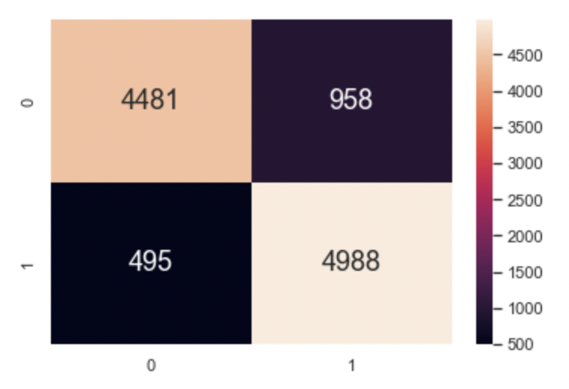
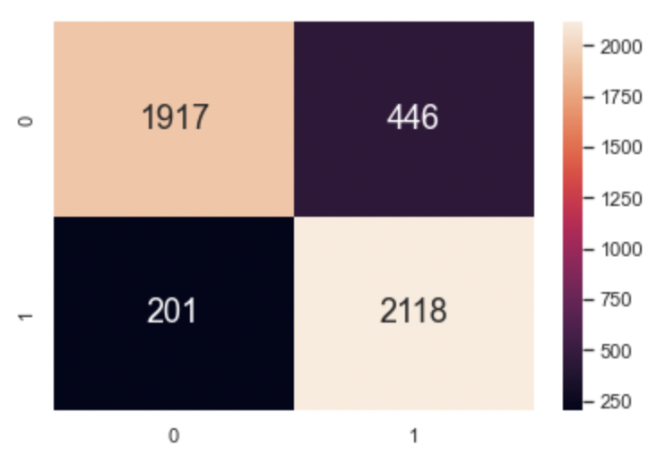
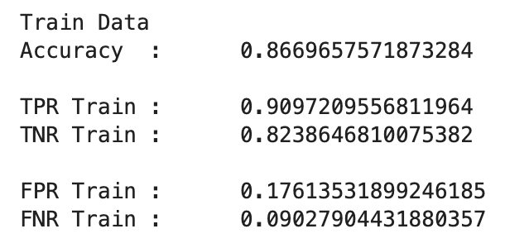
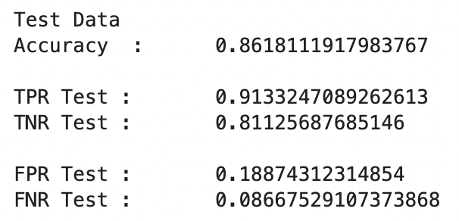
With the use of GridSearchCV, we found the optimal hyper-parameters to maximize accuracy of the classifier on the test set in general.
The model now is able to determine the True Positive value and True Negative value reasonably.
Accuracy is around 0.86.
After using Random Forest & GridSearch

Slide 21
Project Goal
This optimised Decision Tree can best identify the risk of a personal having heart disease based on personal habits.
Individuals or healthcare workers may use this model to check the risk of a person having heart disease.
Things we learn
Upsample when the entries of response variable is very imbalance.
Applies Random Forest and GridSearchCV at the same time to find the optimized model for this problem.
Conclusion

Slide 22

What we have realised

